Slide 1
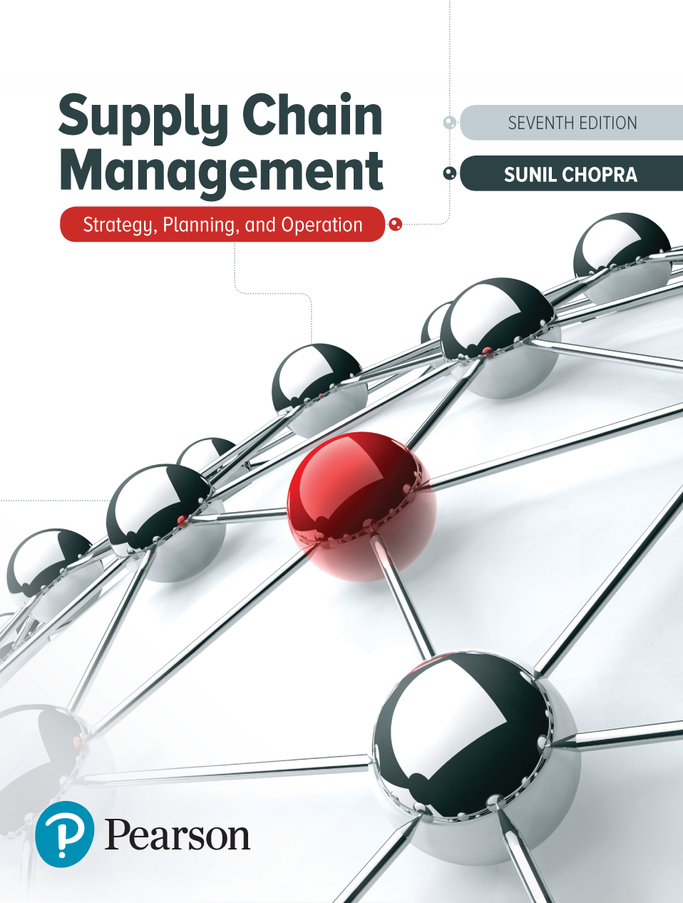
Supply Chain Management: Strategy, Planning, and Operation
Seventh Edition
Chapter 2
Achieving Strategic Fit in a Supply Chain
Copyright © 2019, 2016, 2013 Pearson Education, Inc. All Rights Reserved
Notes:
If this PowerPoint presentation contains mathematical equations, you may need to check that your computer has the following installed:
1) MathType Plugin
2) Math Player (free versions available)
3) NVDA Reader (free versions available)

Slide 2
Learning Objectives
2.1 Explain why achieving strategic fit is critical to a company’s overall success.
2.2 Describe how a company achieves strategic fit between its supply chain strategy and its competitive strategy.
2.3 Identify the main levers to deal with uncertainty in a supply chain.
2.4 Discuss the importance of expanding the scope of strategic fit across the supply chain.

Slide 3
Competitive and Supply Chain Strategies
Competitive strategy defines the set of customer needs a company seeks to satisfy through its products and services
Product development strategy specifies the portfolio of new products that the company will try to develop
Marketing and sales strategy specifies how the market will be segmented and product positioned, priced, and promoted
Supply chain strategy determines the nature of material procurement, transportation of materials, manufacture of product or creation of service, distribution of product, follow-up service, whether processes will be in-house or outsourced
All functional strategies must support one another and the competitive strategy

Slide 4
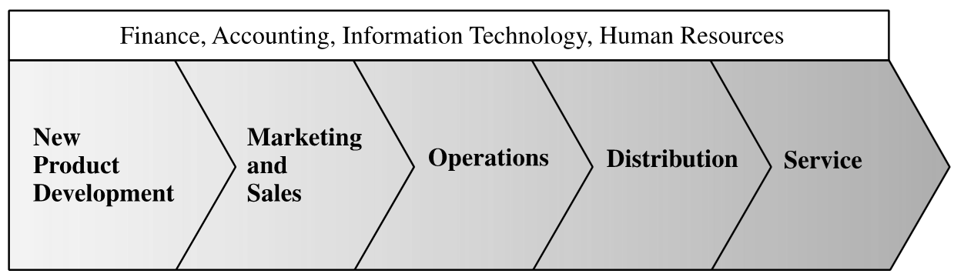
The Value Chain
Figure 2-1 The Value Chain in a Company

Slide 5
Achieving Strategic Fit (1 of 2)
Strategic fit – competitive and supply chain strategies have aligned goals
A company may fail because of a lack of strategic fit or because its overall supply chain design, processes, and resources do not provide the capabilities to support the desired strategy

Slide 6
Achieving Strategic Fit (2 of 2)
The competitive strategy and all functional strategies must fit together to form a coordinated overall strategy. Each functional strategy must support other functional strategies and help a firm reach its competitive strategy goal.
The different functions in a company must appropriately structure their processes and resources to be able to execute these strategies successfully.
The design of the overall supply chain and the role of each stage must be aligned to support the supply chain strategy.

Slide 7
Summary of Learning Objective 1
Strategic fit requires that all functions within a firm and stages in the supply chain target the same goal—one that is consistent with customer needs. A lack of strategic fit between the competitive and supply chain strategies can result in the supply chain taking actions that are not consistent with customer needs, leading to a reduction in supply chain surplus and a decrease in supply chain profitability.

Slide 8
How Is Strategic Fit Achieved?
Understanding the customer and supply chain uncertainty
Understanding the supply chain capabilities
Achieving strategic fit

Slide 9
Step 1: Understanding the Customer and Supply Chain Uncertainty (1 of 2)
Quantity of product needed in each lot
Response time customers are willing to tolerate
Variety of products needed
Service level required
Price of the product
Desired rate of innovation in the product

Slide 10
Step 1: Understanding the Customer and Supply Chain Uncertainty (2 of 2)
Demand uncertainty – uncertainty of customer demand for a product
Implied demand uncertainty – resulting uncertainty for only the portion of the demand that the supply chain plans to satisfy based on the attributes the customer desires

Slide 11
Customer Needs and Implied Demand Uncertainty
Table 2-1 Impact of Customer Needs on Implied Demand Uncertainty
Customer Need | Causes Implied Demand Uncertainty to …
Range of quantity required increases | Increase because a wider range of the quantity required implies greater variance in demand
Lead time decreases | Increase because there is less time in which to react to orders
Variety of products required increases | Increase because demand per product becomes less predictable
Required service level increases | Increase because the firm now has to handle unusual surges in demand
Rate of innovation increases | Increase because new products tend to have more uncertain demand
Number of channels through which product may be acquired increases | Increase because the total customer demand per channel becomes less predictable

Slide 12
Implied Uncertainty and Other Attributes (1 of 2)
Products with uncertain demand are often less mature and have less direct competition. As a result, margins tend to be high.
Forecasting is more accurate when demand has less uncertainty.
Increased implied demand uncertainty leads to increased difficulty in matching supply with demand. For a given product, this dynamic can lead to either a stockout or an oversupply situation.
Markdowns are high for products with greater implied demand uncertainty because oversupply often results.

Slide 13
Implied Uncertainty and Other Attributes (2 of 2)
Table 2-2 Correlation Between Implied Demand Uncertainty and Other Attributes
Blank | Low Implied Uncertainty | High Implied Uncertainty
Product margin | Low | High
Average forecast error | 10% | 40% to 100%
Average stockout rate | 1% to 2% | 10% to 40%
Average forced season-end markdown | 0% | 10% to 25%

Slide 14
Impact of Supply Source Capability
Table 2-3 Impact of Supply Source Capability on Supply Uncertainty
Supply Source Capability | Causes Supply Uncertainty to...
Frequent breakdowns | Increase
Unpredictable and low yields | Increase
Poor quality | Increase
Limited supply capacity | Increase
Inflexible supply capacity | Increase
Evolving production process | Increase

Slide 15
Implied Uncertainty (Demand and Supply) Spectrum
Figure 2-2 The Implied Uncertainty (Demand and Supply) Spectrum

Slide 16
Step 2: Understanding Supply Chain Capabilities (1 of 2)
How does the firm best meet demand?
Supply chain responsiveness is the ability to
Respond to wide ranges of quantities demanded
Meet short lead times
Handle a large variety of products
Build highly innovative products
Meet a high service level
Handle supply uncertainty

Slide 17
Step 2: Understanding Supply Chain Capabilities (2 of 2)
Responsiveness comes at a cost
Supply chain efficiency is the inverse to the cost of making and delivering the product to the customer
The cost-responsiveness efficient frontier curve shows the lowest possible cost for a given level of responsiveness

Slide 18
Cost-Responsiveness Efficient Frontier
Figure 2-3 Cost-Responsiveness Efficient Frontier

Slide 19
Responsiveness Spectrum
Figure 2-4 The Responsiveness Spectrum

Slide 20
Step 3: Achieving Strategic Fit
Ensure that the degree of supply chain responsiveness is consistent with the implied uncertainty
Assign roles to different stages of the supply chain that ensure the appropriate level of responsiveness
Ensure that all functions maintain consistent strategies that support the competitive strategy

Slide 21
Zone of Strategic Fit
Figure 2-5 Finding the Zone of Strategic Fit

Slide 22
Roles and Allocations
Figure 2-6 Different Roles and Allocations of Implied Uncertainty for a Given Level of Supply Chain Responsiveness

Slide 23
Efficient and Responsive Supply Chains
Table 2-4 Comparison of Efficient and Responsive Supply Chains
Blank | Efficient Supply Chains | Responsive Supply Chains
Primary goal | Supply demand at the lowest cost | Respond quickly to demand
Product design strategy | Maximize performance at a minimum product cost | Create modularity to allow postponement of product differentiation
Pricing strategy | Lower margins because price is a prime customer driver | Higher margins because price is not a prime customer driver
Manufacturing strategy | Lower costs through high utilization | Maintain capacity flexibility to buffer against demand/supply uncertainty
Inventory strategy | Minimize inventory to lower cost | Maintain buffer inventory to deal with demand/supply uncertainty
Lead-time strategy | Reduce, but not at the expense of costs | Reduce aggressively, even if the costs are significant
Supplier strategy | Select based on cost and quality | Select based on speed, flexibility, reliability, and quality

Slide 24
Tailoring the Supply Chain
Achieve strategic fit while serving many customer segments with a variety of products across multiple channels
Requires sharing operations for some links in the supply chain, while having separate operations for other links

Slide 25
Changes over Product Life Cycle (1 of 2)
Beginning stages
Demand is very uncertain, and supply may be unpredictable
Margins are often high, and time is crucial to gaining sales
Product availability is crucial to capturing the market
Cost is often a secondary consideration

Slide 26
Changes over Product Life Cycle (2 of 2)
Later stages
Demand has become more certain, and supply is predictable
Margins are lower as a result of an increase in competitive pressure
Price becomes a significant factor in customer choice

Slide 27
Summary of Learning Objective 2
To achieve strategic fit, a company must first understand the needs of the customers being served and the capabilities of all supply sources. Both the needs and the capabilities should be used to identify the implied uncertainty that the supply chain must absorb. The second step is to understand the supply chain’s capabilities in terms of efficiency and responsiveness. The key to strategic fit is ensuring that supply chain responsiveness is consistent with customer needs, supply capabilities, and the resulting implied uncertainty. Tailoring the supply chain is essential to achieving strategic fit when supplying a wide variety of customers with many products through different channels.

Slide 28
Supply Chain Levers
Five basic levers to deal with uncertainty
Capacity, combination of excess capacity and flexible capacity
Inventory, one of the most common levers used in practice to deal with uncertainty
Time, combination of speedy supply and the willingness of customers to wait
Information, appropriate information can help a supply chain reduce uncertainty
Price, prices of products and services that vary over time

Slide 29
Supply Chain Uncertainty
Figure 2-7 Five Key Levers to Deal with Supply Chain Uncertainty

Slide 30
Summary of Learning Objective 3
The implied uncertainty that a supply chain needs to absorb depends on the needs of the customer segment(s) targeted. Capacity, inventory, time, information, and price are the five levers that a supply chain can use to deal with this uncertainty. Investing more in one lever generally allows the supply chain to invest less in one or more of the other levers. To achieve strategic fit, a supply chain must find the right balance between investments in the five levers to effectively serve the target customer segment(s).

Slide 31
Expanding Strategic Scope (1 of 3)
Scope of strategic fit – the functions within the firm and stages across the supply chain that devise an integrated strategy with an aligned objective
Intraoperation Scope: Minimizing Local Cost
Each stage of the supply chain devises strategy independently

Slide 32
Expanding Strategic Scope (2 of 3)
Intrafunctional Scope: Minimizing Functional Cost
Firms align all operations within a function
Interfunctional Scope: Maximizing Company Profit
Functional strategies are developed to align with one another and with the competitive strategy

Slide 33
Expanding Strategic Scope (3 of 3)
Intercompany Scope: Maximizing Supply Chain Surplus
Supplier and customer work together and share information to reduce total cost and increase supply chain surplus
Agile Intercompany Scope
A firm’s ability to achieve strategic fit when partnering with supply chain stages that change over time

Slide 34
Summary of Learning Objective 4
The scope of strategic fit refers to the functions and stages within a supply chain that coordinate strategy and target a common goal. When the scope is narrow, individual functions try to optimize their performance based on their own goals. This practice often results in conflicting actions that reduce the supply chain surplus. As the scope of strategic fit is enlarged to include the entire supply chain, actions are evaluated based on their impact on overall supply chain performance, which helps increase supply chain surplus.

Slide 35

Copyright

